Slide 1
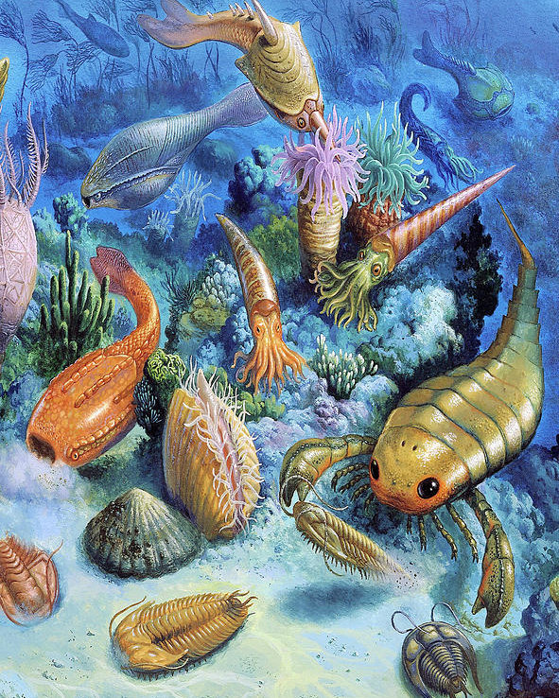


EXTINCTION RATES OF TRILOBITES IN THE PERIOD BETWEEN THE SILURIAN AND DEVONIAN
Analytical Palaeobiology project
03.07.2020
Francesca Cusumano

Slide 2

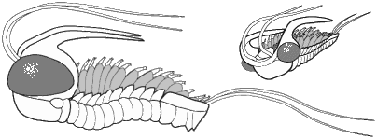
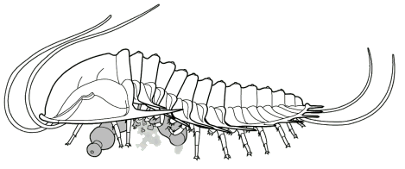
Trilobites first appeared during the Cambrian (520 Ma) and disappeared at one of the major extinction event at end of the Permian (250 Ma).
Background
10 Orders: Agnostida, Redlichiida, Corynexochida, Lichida, Odontopleurida, Phacopida, Proetida, Asaphida, Harpetida and Ptychopariida.
Nutrition:
1- Predators and scavengers;
2- Detritivores;
3- Pelagic plankton feeder;
4- Filter feeder;
5- Planktonic/pseudoplanktonic

Slide 3
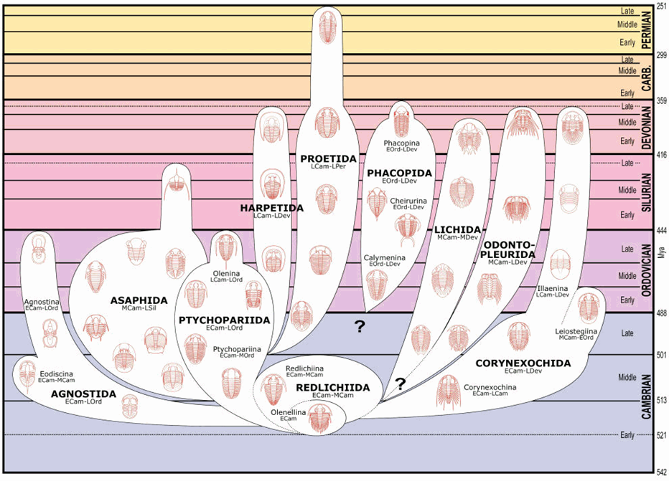
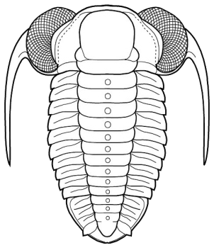
They have been studied in many aspects:
Body patterning and their evolution rates;
The distribution of some orders in space and time;
Phylogenetic (e.g. the work of Patterson et al., 2019).
Background
They have shown a complex evolution
Between the Middle and Late Devonian, a series of extinction events led to a dramatic taxonomic impoverishment of the trilobites .
As for the time interval between the Early Silurian and the late Devonian, it was seen that many of the orders were still present and at the end of the Devonian, many orders of trilobites became extinct.
Image from google

Slide 4

Questions…
Which is the extinction rate in the time between the Silurian and Devonian?
What result we can obtain if we compare this group with another, such as the brachiopods, bivalves or gastropods ?
We can obtain a high extinction rate for the trilobites in the time interval selected? If yes, it is comparable with the one of the brachiopods?
Aim
The extinction rate for trilobites, during the time interval between the Silurian and Devonian, can show higher values if compared to other groups.

Slide 5
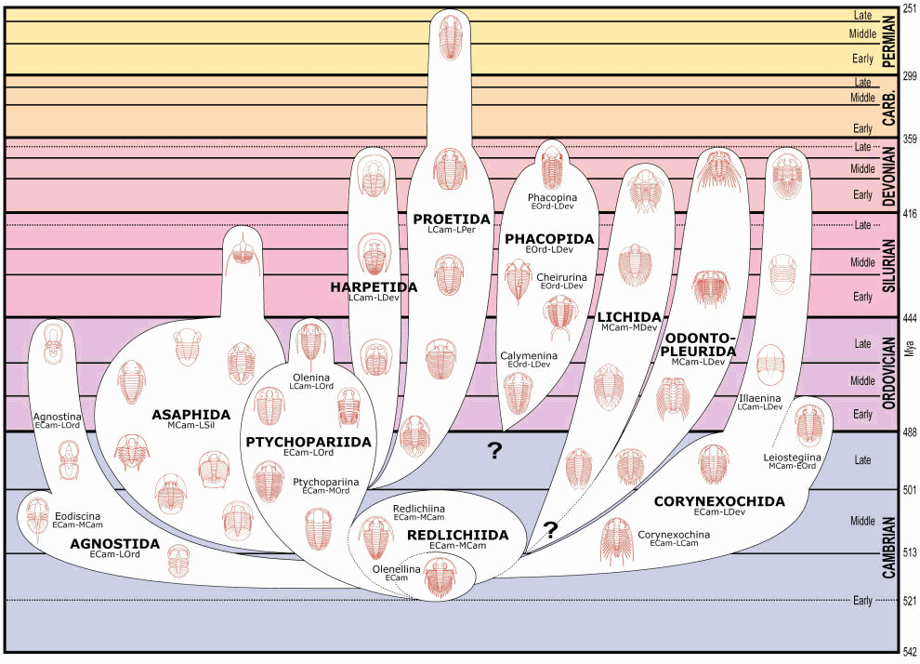
Aim
Image from google

Slide 6

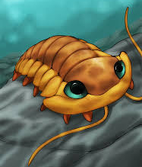
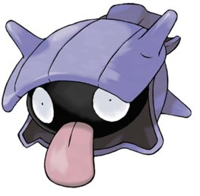
Aim

Slide 7



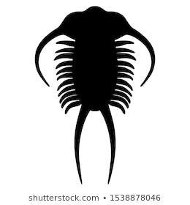
Diversity dynamics of this group;
Comparing with the one obtained for brachiopods.
Packages:
Chronosphere
divDyn 0.8.0
Methods
Data: chronosphere;
Genus level;
Stages and ten;
divDyn();
Subsampling;
Turnover rate;
ratesplit().

Slide 8

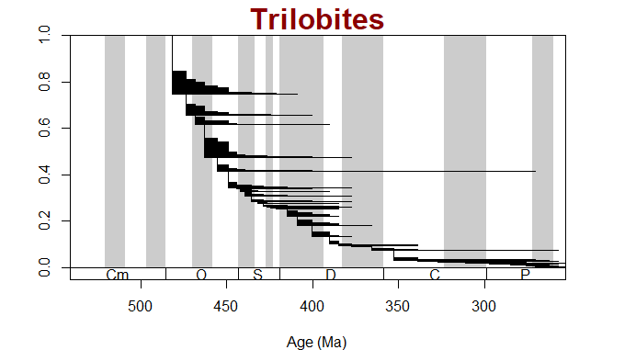
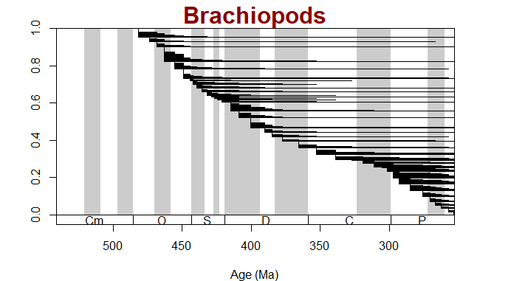
BASIC PATTERNS OF THE STRATIGRAPHIC RANGES
Results
53.671 observations and 72 variables trb 177.546 observations and 72 variables for brh

Slide 9
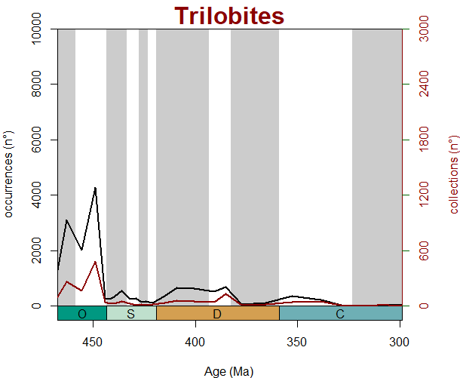
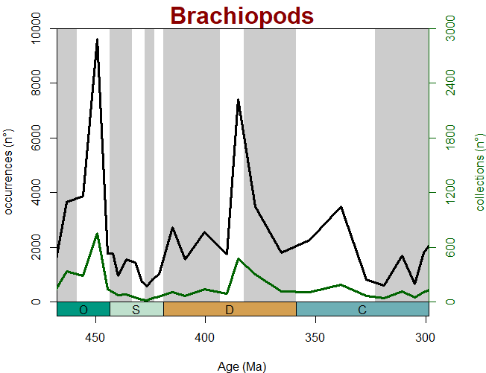
OCCURRENCES VS COLLECTIONS
Results
Givetian
Givetian

Slide 10
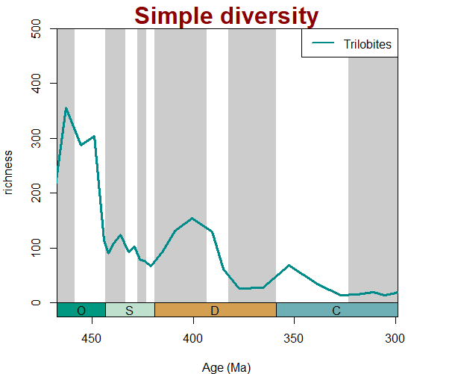
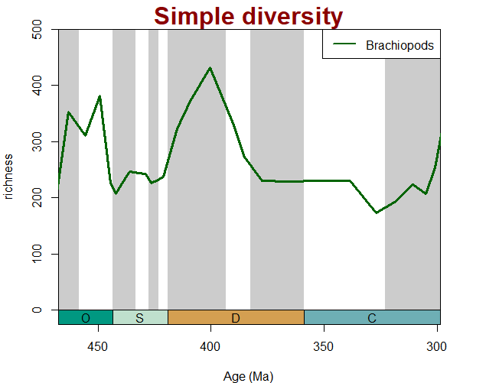
RICHNESS THROUGH TIME
divDyn function
Results
EMSIAN
EMSIAN

Slide 11
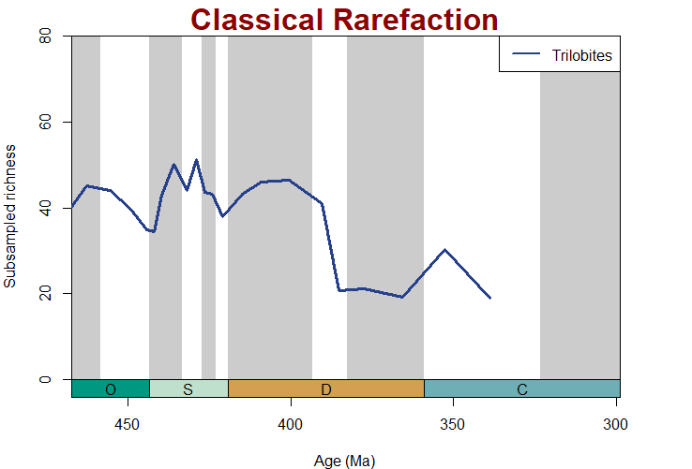
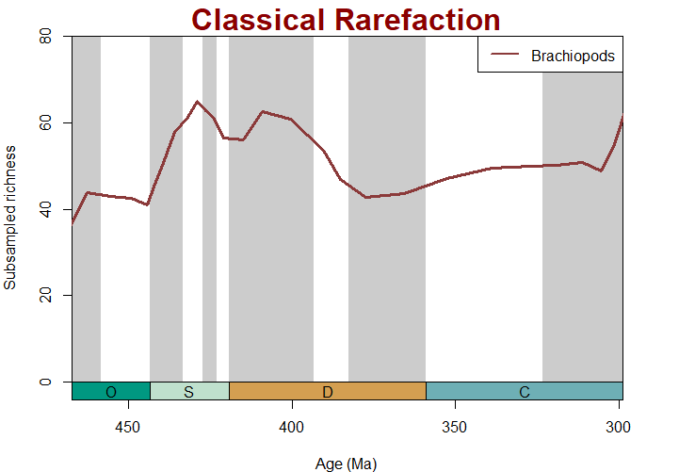
SUBSAMPLING
cor.test ();
Classical Rarefaction.
Results
Telychian and Homerian
Homerian and Pragian
rho
0.9501671
rho
0.9070366

Slide 12
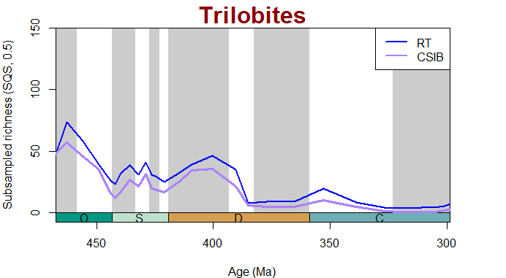
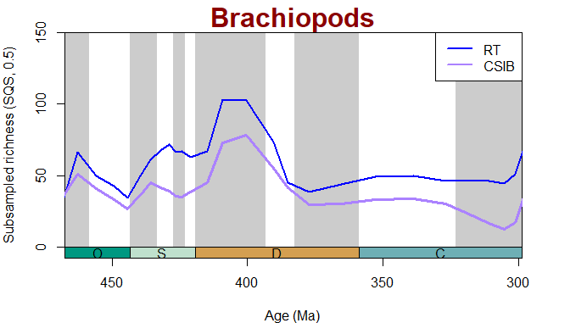
SHAREHOLDER QUORUM SUBSAMPLING (SQS)
Results
The likely trajectory of trilobites and brachiopods diversities through time:
Pragian
Emsian
Emsian
Range-through diversities (RT)
Corrected Sampled-in-bin (CSIB) diversity

Slide 13
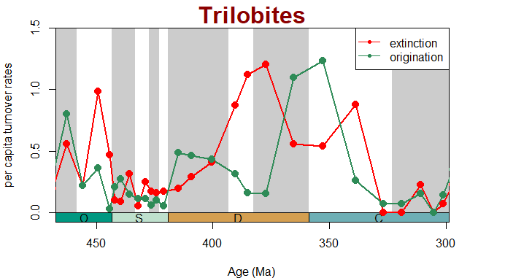
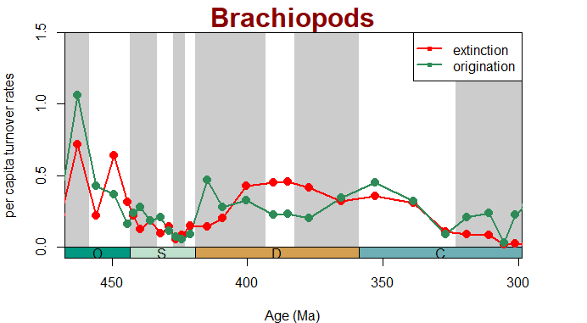
TURNOVER RATES
per capita extinction and origination rates of Foote (1999).
Results

Slide 14
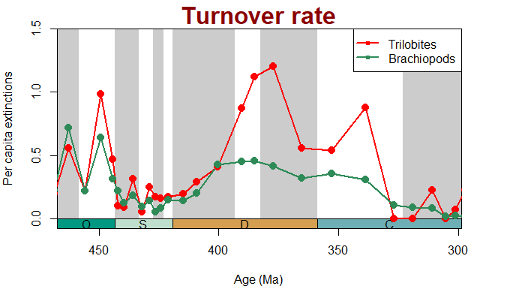
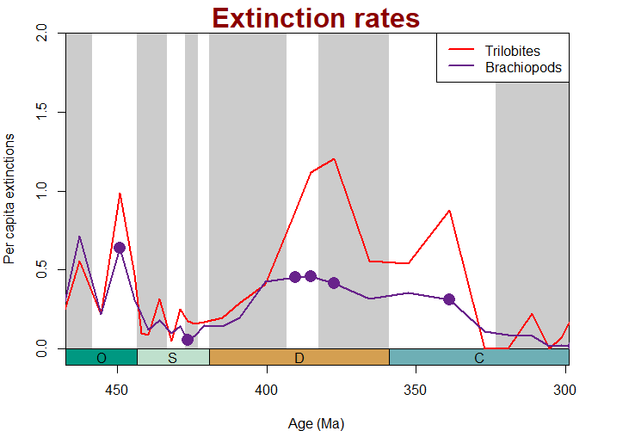
Comparing the extinction rates of Trilobites and Brachiopods in one graph;
Statistical analysis using the test of rate split (selectivity)
Results
Frasnian
Gorstian
Eifelian and Givetian

Slide 15

Which is the extinction rate in the time between the Silurian and Devonian?
Apparently the trilobites show and high extinction rate in the middle-late Devonian.
What result we can obtain if we compare this group with another, such as the brachiopods?
From the comparison of the two groups is evident how the extinction rates of trilobites is greater than the one of brachiopods.
We can obtain a high extinction rate for the trilobites in the time interval selected? If yes, it is comparable with the one of the brachiopods?
The two groups show marked differences in the Gorstian (middle Silurian) and in the Eifelian, Givetian and Frasnian stages (middle-upper Devonain).
Conclusion

Slide 16
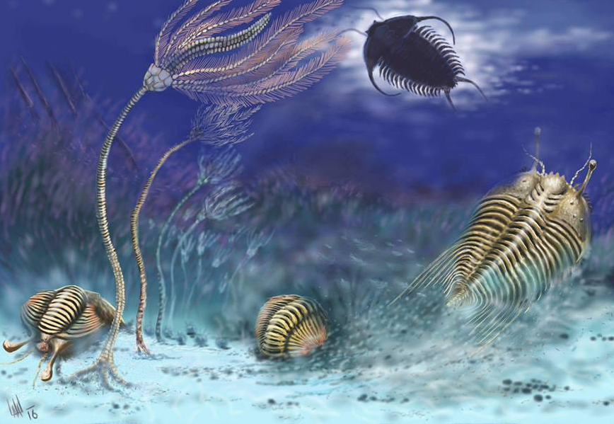
THANK YOU..
…QUESTIONS?

Slide 17
References
I. Chlupac (1973). The distribution of phacopid trilobite s in space and time. Fossils and Strata, No. 4, pp. 399-408.
A. J. Boucot and J. D. Lawson (1985). Late Silurian-Early Devonian Biogeography, Provincialism, Evolution and Extinction. Royal Society.Vol. 309.
Nigel C. Hughes (2003). Trilobite body patterning and the evolution of arthropod tagmosis. Integrative and Comparative Biology, Vol. 43, pp. 185–206.
J. R. Paterson, G. D. Edgecombe, M. S. Y. Lee (2019 ). Trilobite evolutionary rates constrain the duration of the Cambrian explosion. PNAS,No. 116 (10) 4394-4399

